Slide 1
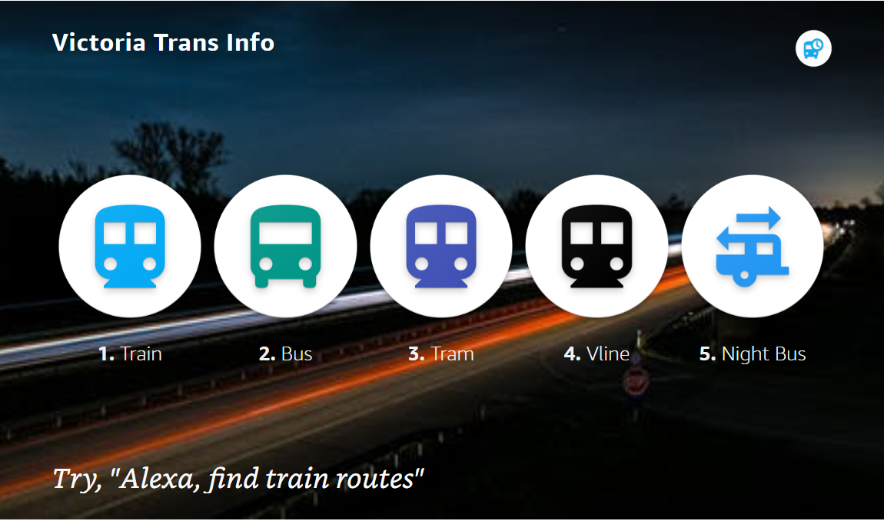
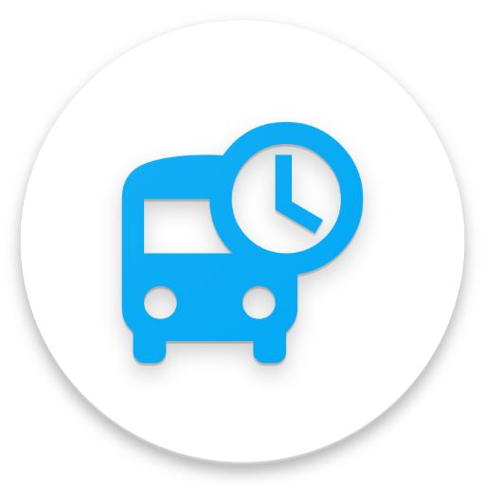

Victoria Trans Info
Alexa skill to get Info for ‘Public Transport Victoria’
Alexa Skill information of Public Transport Victoria
https://www.ptv.vic.gov.au/

Slide 2
Victoria Trans Info
Alexa skill “Victoria trans info” provides various information about routes, stops, departures and nearby stops for Public Transport Victoria (PTV) of Autralia. (https://www.ptv.vic.gov.au/) .
Objective of the skill is to get latest and up to date information using public API provided by the PTV for the developers. All the information is taken is using the API provided by PTV
Launch Request
“Alexa, open Victoria trans info”
“Alexa, ask Victoria trans info to find routes”
“Alexa, ask Victoria trans info to search nearby stops”

Slide 3
Intents
Get Modes
"tell me all types of transport"
Get Routes
"get routes ",
Get Stops
Get Departures
Search Nearby Stops
Get Stop Info
"get transport modes"
"find routes for train"
“get stops"
“get train stops
"get train departures",
"get departures"
"get stop info"
"get stop info for Alamein
"search nearby stops",
"find stops near me"

Slide 4
Victoria Transport Data Structure
PTV
Train
Route
Route
Bus
Route
Tram
VLine
Night Bus
Stop
Stop
Stop
Stop
Route
Route
Route
Stop
Stop
Stop
Stop
Stop
Stop Info
Stop Info
Stop Info
Stop Info
Stop Info
Stop Info
Stop Info
Stop Info
Stop Info
Departures
Departures

